Slide 1
CareAir: Explainable Reasoning for Healthcare Ventilation Compliance
Team HVCC : Ahosan Habib · Nipun Deelaka · Andy Cheng · Carina Liu
Ontology Engineering 2026 (CSCI 6340) · Assignment 9 · Project Presentation

Slide 2
Contents
CareAir · Team HVCC · Assignment 9
01
Usage Scenario + Conceptual Model
Hospital ventilation compliance and project motivation
02
Use Case Description
Overview 3 use cases and background to CQ
03
Competency Questions & SPARQL
CQ 2.1 · CQ 2.2 · CQ 3.1 · CQ 3.2
04
Reasoning & Query Evidence
OWL DL, SWRL rules, and Protégé results
05
AI Use
Tools used and verification of results
ONTOLOGY ENGINEERING 2026 / PROJECT PRESENTATION

Slide 3
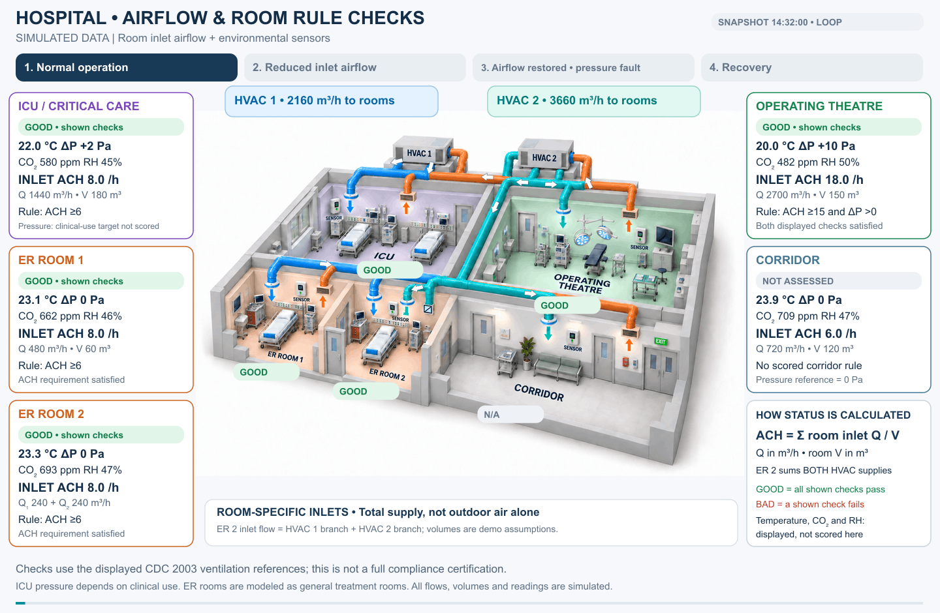
Usage Scenario

Slide 4
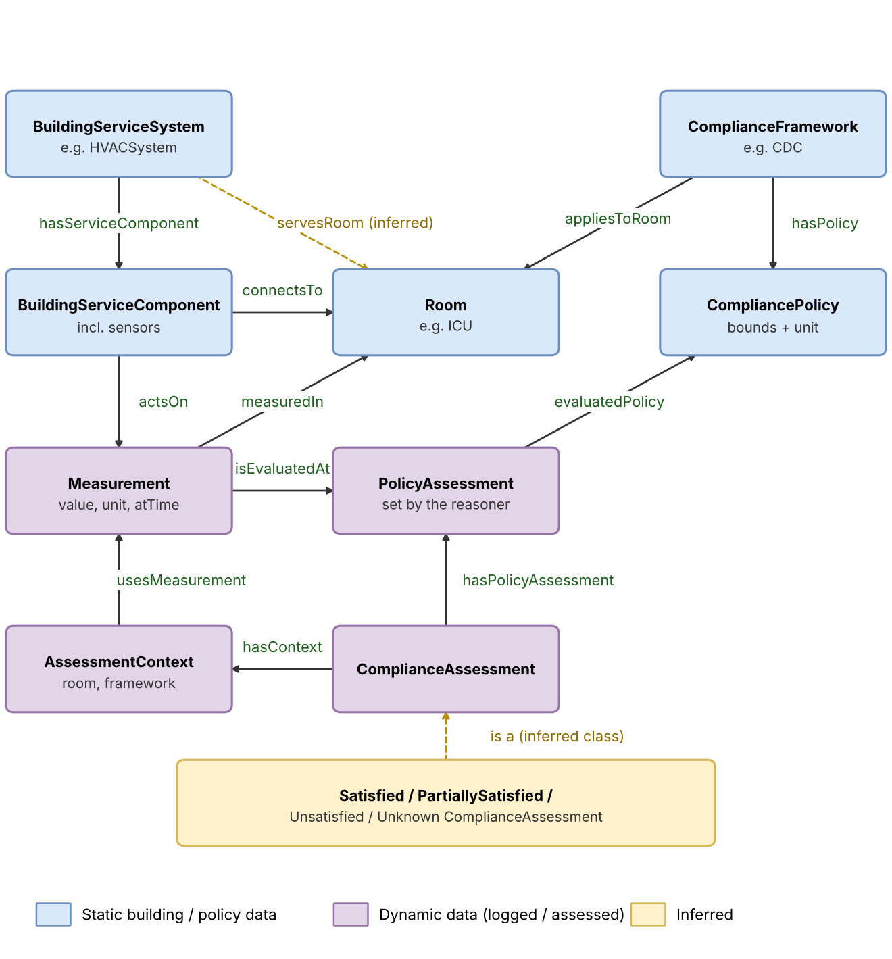
(Overview) Conceptual Model

Slide 5
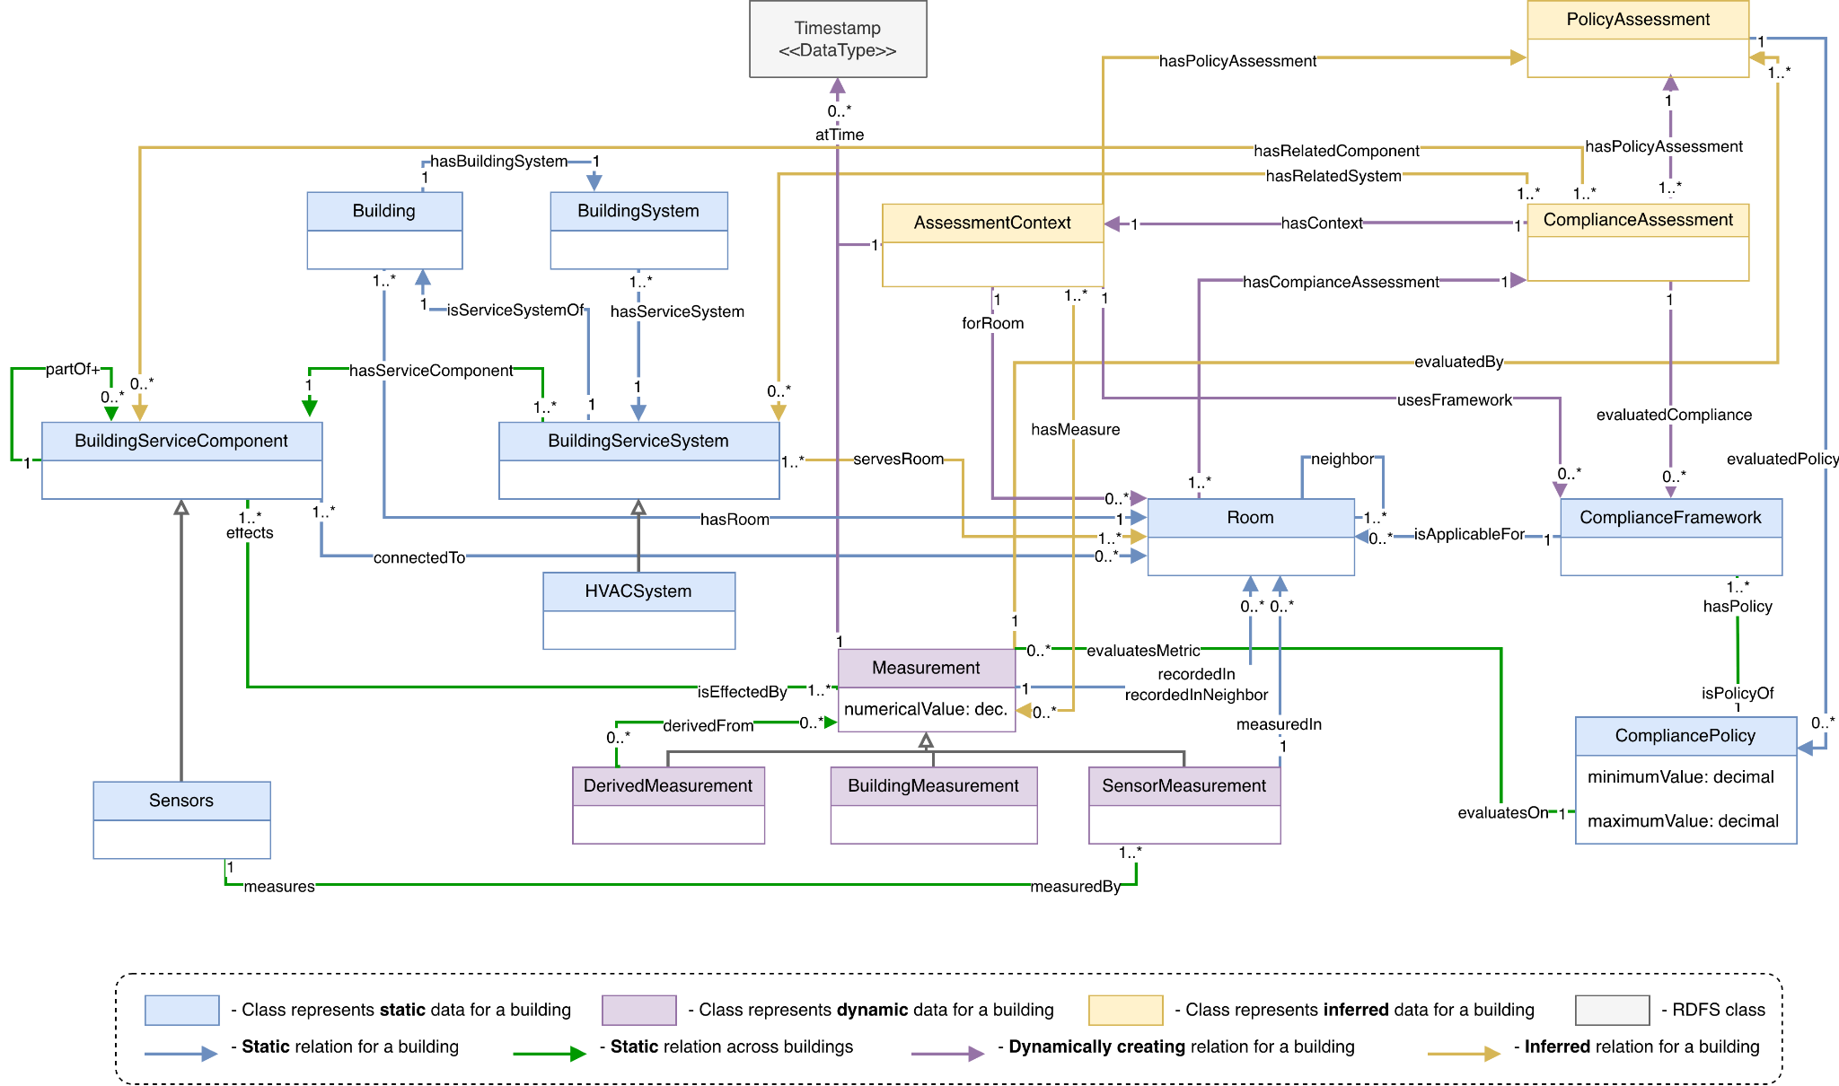
(Full) Conceptual Model [before]

Slide 6
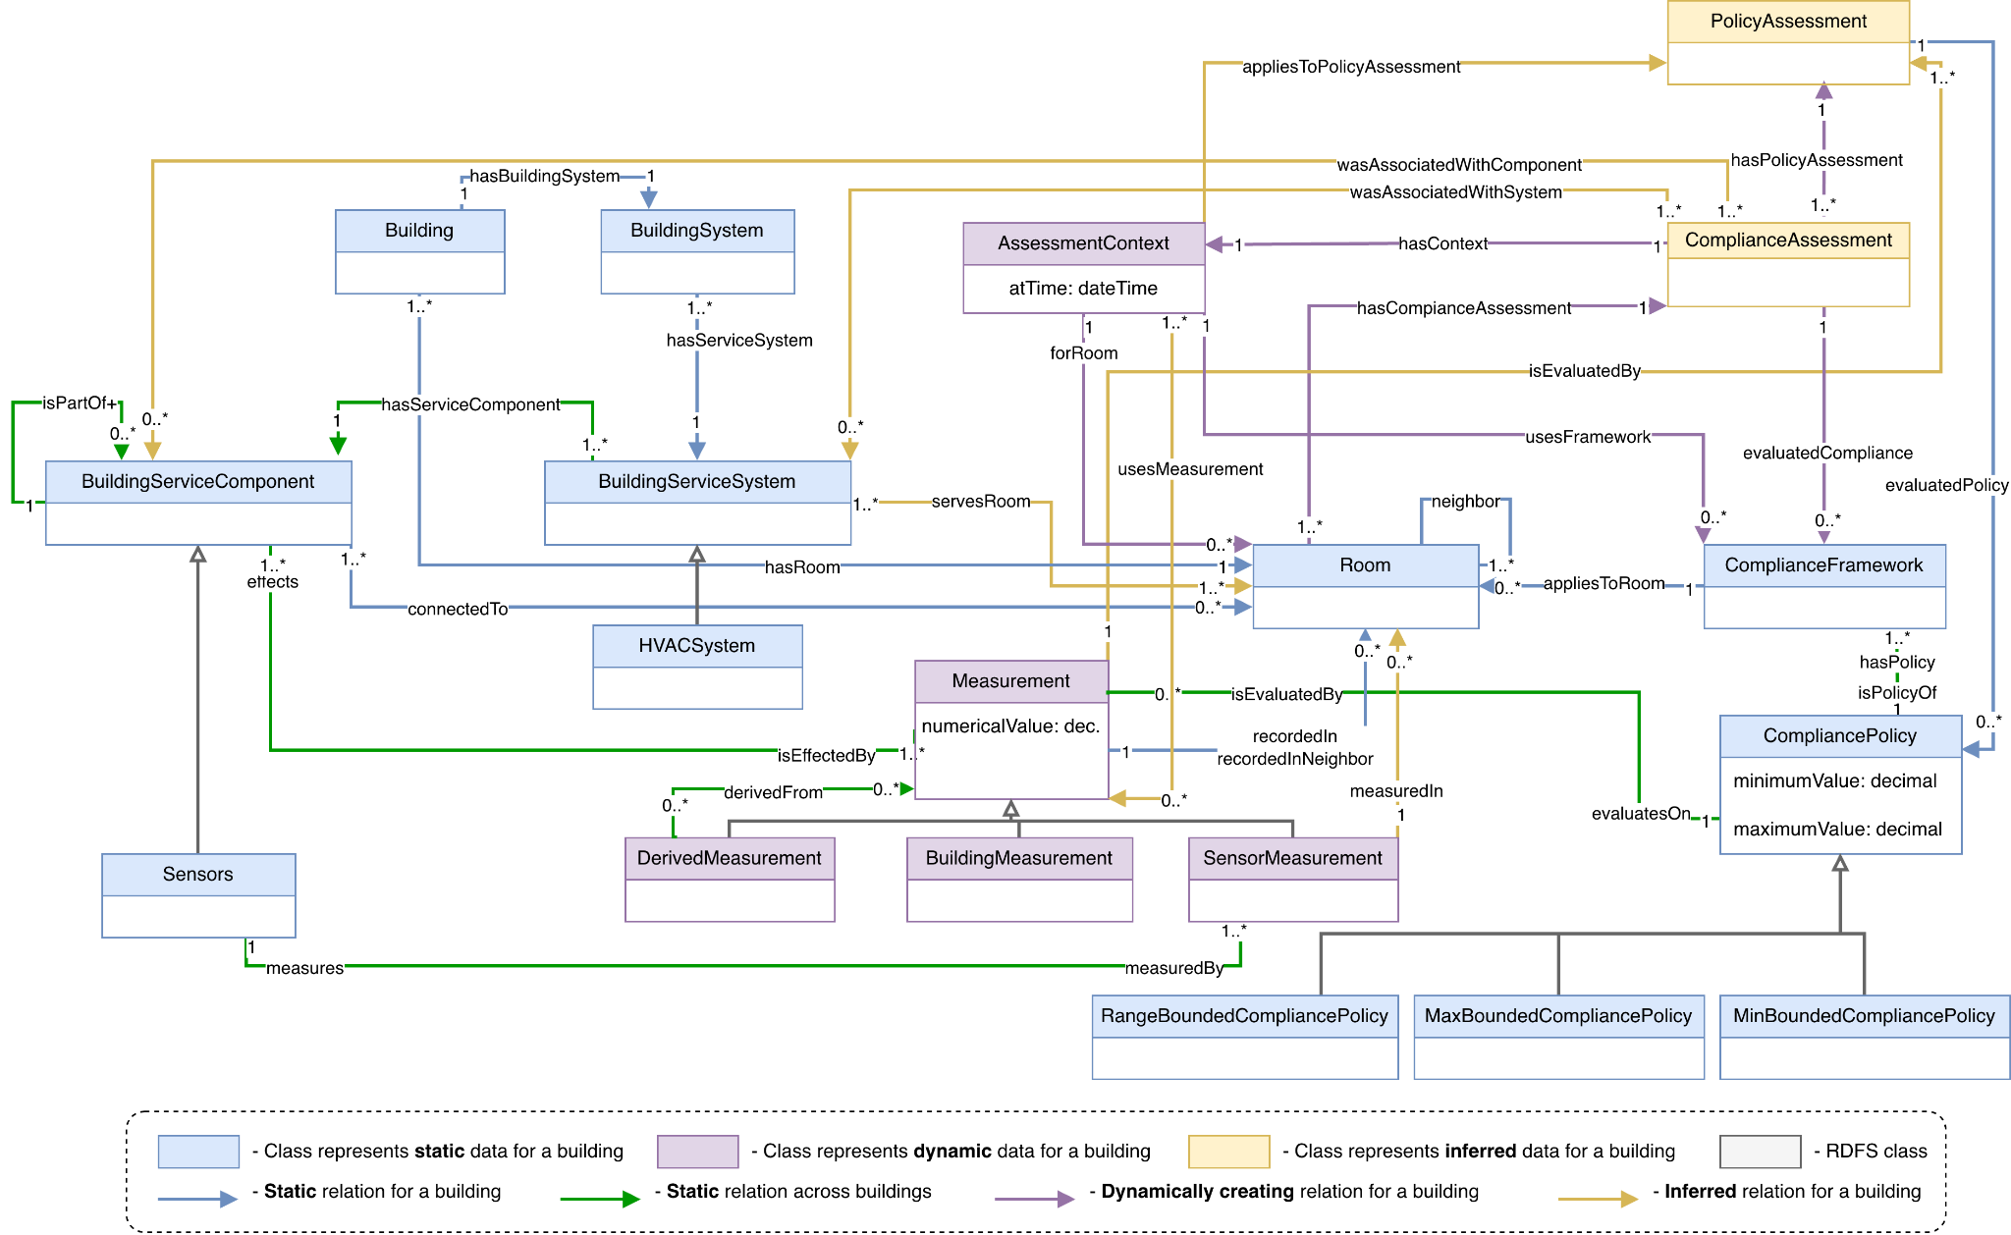
(Full) Conceptual Model [now]
changes

Slide 7
Use Case : Rooms
TEST SCENARIO / 9 OCTOBER 2026
ICU-01
ICU-02
ICU-03
OUTDOOR AIR
OUTDOOR AIR
OUTDOOR AIR
1.4 ACH
14:30:00
2.6 ACH
14:30:00
3.1 ACH
14:30:00
RELATIVE HUMIDITY
RELATIVE HUMIDITY
RELATIVE HUMIDITY
45% RH
14:30:00
40% RH
14:30:00
50% RH
14:30:00
ACH = air changes per hour | Each reading keeps its value, unit and timestamp.

Slide 8
Use Case : Compliance Policies
CDC FRAMEWORK → SAME TWO RULES FOR ALL THREE ROOMS
OUTDOOR AIR CHANGES
RELATIVE HUMIDITY
≥ 2 ACH
30–60% RH
Minimum outdoor air per hour
Allowed range
CDC Environmental Infection Control (2003), Appendix B, Table B.2 · Critical and intensive care
Scope: these two modeled policies only; other CDC requirements are outside this test.

Slide 9
Use Case : Actors and Questions
System admin
Healthcare admin
Maintenance technician
Carina
Andy
Ahosan
Which HVAC systems
serve which rooms & their current sensor feed?
Which rooms meet the Compliance
at a given time?
Which system and components
may have been failed?
CQ 1.1–1.2
CQ 2.1–2.2
CQ 3.1–3.2

Slide 10
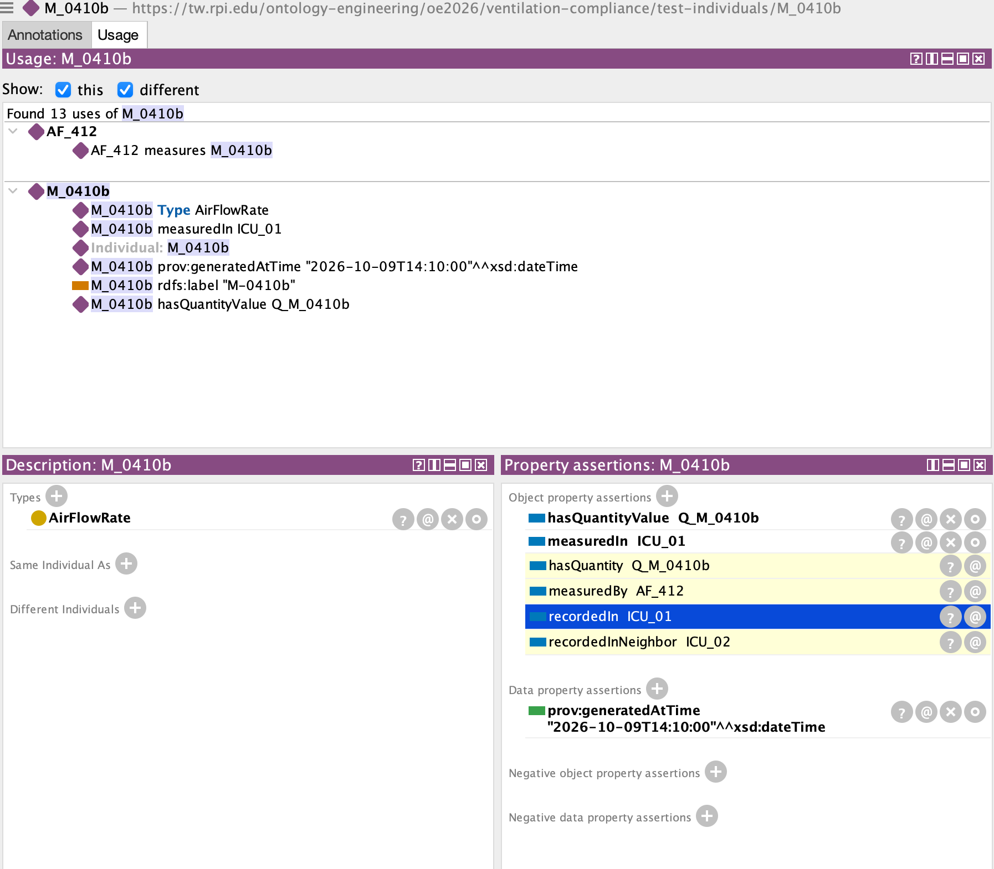
Competency Question 1.2
Which sensor readings have been recorded in room ICU_01, and which sensors produced them?
SPARQL – Snap SPARQL Query tab, Pellet started
Reasoning required – OWL DL
PREFIX v: <https://tw.rpi.edu/ontology-engineering/oe2026/ventilation-compliance/ventilation-compliance/>
PREFIX qu: <https://www.omg.org/spec/Commons/QuantitiesAndUnits/>
PREFIX prov: <http://www.w3.org/ns/prov#>
PREFIX rdfs: <http://www.w3.org/2000/01/rdf-schema#>
SELECT DISTINCT ?roomName ?readingName ?value ?unit ?time
WHERE {
?reading v:recordedIn ?room .
?room rdfs:label ?roomName .
?reading rdfs:label ?readingName .
?reading prov:generatedAtTime ?time .
OPTIONAL {
?reading qu:hasQuantityValue ?quantity .
?quantity qu:hasNumericValue ?value ;
qu:hasMeasurementUnit ?unit .
}
}
ORDER BY ?roomName ?time ?readingName
Sensor connects to a room
Sensor measures has measured by a sensor
Sensor measures has measured in the room that sensor is connected to

Slide 11
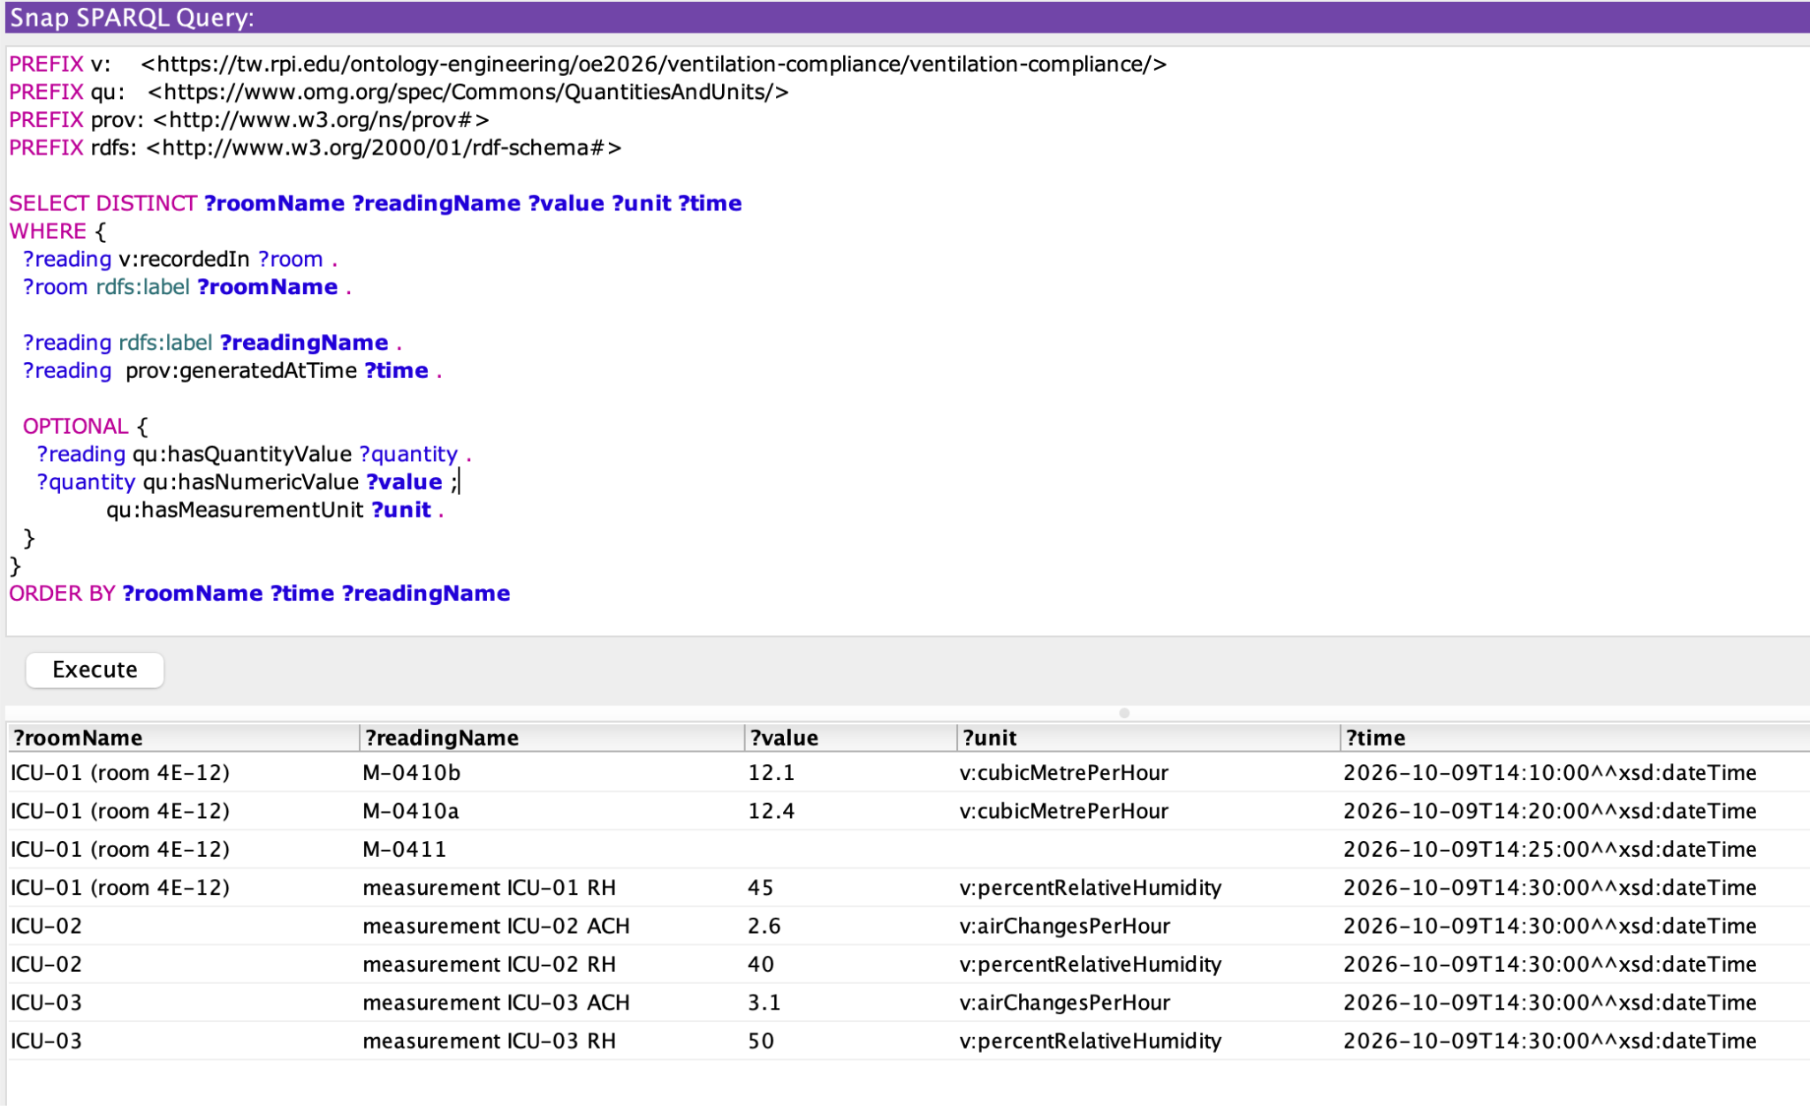
Competency Question 1.2
Which sensor readings have been recorded in room 4E-12, and which sensors produced them?

Slide 12
Competency Question 2.1
Which ICU rooms met the CDC ventilation standard in the 14:30 test on 9 October 2026?
SPARQL – Snap SPARQL Query tab, Pellet started
Reasoning required – OWL DL with SWRL rules
SELECT DISTINCT ?roomName ?time ?standardName
?policyName ?status
WHERE {
?assessment v:hasContext ?context .
?assessment v:hasPolicyAssessment ?pa .
?context v:forRoom ?room .
?context v:usesFramework ?standard .
?context v:usesMeasurement ?measurement .
?measurement v:isEvaluatedAt ?pa .
?measurement prov:generatedAtTime ?time .
?pa v:evaluatedPolicy ?policy .
?pa rdf:type ?status .
?room rdfs:label ?roomName .
?standard rdfs:label ?standardName .
?policy rdfs:label ?policyName .
FILTER (?status = v:SatisfiedPolicyAssessment ||
?status = v:UnsatisfiedPolicyAssessment ||
?status = v:UnknownPolicyAssessment)
}
ORDER BY ?roomName ?policyName
1. Policy assessment classification
Pellet applies the SWRL policy comparison rules to infer SatisfiedPolicyAssessment or UnsatisfiedPolicyAssessment.
2. Join room, standard and evidence
The assessment context links each ICU room to the CDC framework and the measurements used for each policy.
3. Return intermediate results
Do not filter only for failures: show room, timestamp, standard, policy and inferred status for all tested policies.
Snap SPARQL result – 6 rows
ICU-01 | ACH: Unsatisfied · RH: Satisfied
ICU-02 / ICU-03 | ACH: Satisfied · RH: Satisfied
Answer – ICU-02 and ICU-03 met both tested policies.
ICU-01 failed outdoor-air ACH, but passed relative humidity. Six policy results; time values reflect individual measurements.
Notes:
CQ 2.1: This query covers two tested policies per room, not all possible CDC ventilation requirements. Explain the six intermediate results and how SWRL infers policy assessment status.

Slide 13
Competency Question 2.2
For ICU-01, which compliance policies were not satisfied, and which measurements show it?
SPARQL – Snap SPARQL Query tab, Pellet started
Reasoning required – policy comparison + evidence
SELECT DISTINCT ?roomName ?policyName ?status
?measurementName ?actual ?minimum ?maximum
?unit ?time
WHERE {
test:A_ICU_01 v:hasContext ?context .
test:A_ICU_01 v:hasPolicyAssessment ?pa .
?context v:forRoom ?room .
?context v:usesMeasurement ?measurement .
?pa v:evaluatedPolicy ?policy .
?pa rdf:type ?status .
?measurement v:isEvaluatedAt ?pa .
?measurement qu:hasQuantityValue ?quantity .
?quantity qu:hasNumericValue ?actual .
?quantity qu:hasMeasurementUnit ?unit .
?measurement prov:generatedAtTime ?time .
?measurement rdfs:label ?measurementName .
?room rdfs:label ?roomName .
?policy rdfs:label ?policyName .
OPTIONAL { ?policy qu:hasLowerBound ?lower .
?lower qu:hasNumericValue ?minimum . }
OPTIONAL { ?policy qu:hasUpperBound ?upper .
?upper qu:hasNumericValue ?maximum . }
}
1. Focus on ICU-01
The assessment and context identify ICU-01 (room 4E-12), and connect its policy assessments to measurements.
2. Compare measurements with bounds
Outdoor ACH: 1.4 < 2.0 minimum (unsatisfied). Relative humidity: 45% is inside 30–60% (satisfied).
3. Explain the answer
SWRL classifies each policy assessment. The query shows the inferred status alongside the measured value, unit, policy bound and time.
Snap SPARQL result – 2 rows
ACH: 1.4 vs ≥ 2.0 | 14:30 | Unsatisfied
RH: 45% vs 30–60% | 14:30 | Satisfied
Answer – ICU-01 fails the minimum outdoor-air ACH policy.
1.4 ACH was recorded at 14:25, below the required 2.0. Relative humidity (45%) was within the 30–60% range.
Notes:
CQ 2.2: The new query intentionally includes a satisfied policy for comparison. Do not imply it validates every CDC policy; it reports the two policy assessments present in the sample data.

Slide 14
Why did ICU-01 fail one ventilation policy?
Question: For room ICU-01, which compliance policies were not satisfied, and which measurements show it?
POLICY-BY-POLICY EVIDENCE · 2 RESULTS
MINIMUM OUTDOOR AIR CHANGES
RELATIVE HUMIDITY RANGE
1.4
45%
ACH measured
RH measured
Required minimum: 2.0 ACH
Allowed range: 30%–60%
UNSATISFIED • 14:30 • M-0412
SATISFIED • 14:30
HOW THE QUERY EXPLAINS THE RESULT
ICU-01 → Policy assessment → Measurement → Actual value + Policy bound → OWL/SWRL status
Notes:
CQ 2.2: This question explains the failure instead of simply reporting a status. For ICU-01, the query displays the policy, its measurement, the actual value, the required limits, the measurement unit, and the time. The outdoor air change rate was 1.4 ACH at 14:25, below the minimum of 2.0, so that policy was inferred unsatisfied. The humidity reading was 45 percent at 14:30, inside the permitted range from 30 to 60 percent, so it was inferred satisfied. Including the passing result as a comparison makes the explanation clearer. The status is inferred through the compliance rules; the query brings the measurement evidence and policy threshold together.

Slide 15
Policy compliance status table
QUERY OUTPUT · 6 POLICY ASSESSMENTS
Room
Compliance policy
Measurement time
Inferred status
ICU-01 (4E-12)
Minimum outdoor ACH
14:30
UNSATISFIED
ICU-01 (4E-12)
Relative humidity
14:30
SATISFIED
ICU-02
Minimum outdoor ACH
14:30
SATISFIED
ICU-02
Relative humidity
14:30
SATISFIED
ICU-03
Minimum outdoor ACH
14:30
SATISFIED
ICU-03
Relative humidity
14:30
SATISFIED
INTERMEDIATE REASONING
Room → Assessment context → CDC framework → Policy assessment → Inferred status
Notes:
CQ 2.1: My first competency question asks which ICU rooms met the CDC ventilation standard. I used SPARQL to connect each room to its assessment context, the CDC framework, the relevant policies, and their inferred status. The query returned six rows: two policies for each of three ICU rooms. ICU-01 failed the minimum outdoor-air-change policy but passed relative humidity. ICU-02 and ICU-03 passed both tested policies. We deliberately include both satisfied and unsatisfied results to show the intermediate reasoning. This is based on the two policies represented in our test data, not a claim that every CDC requirement was tested.

Slide 16
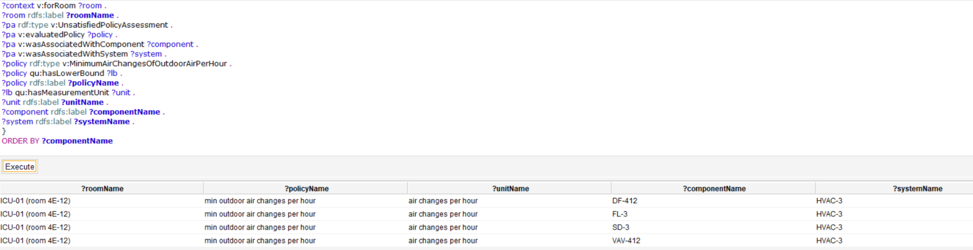
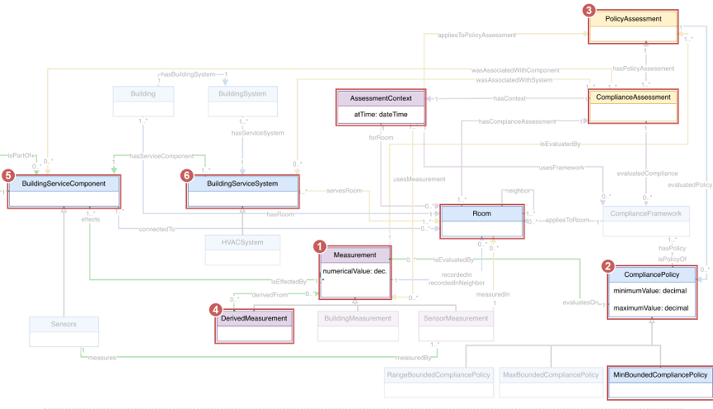
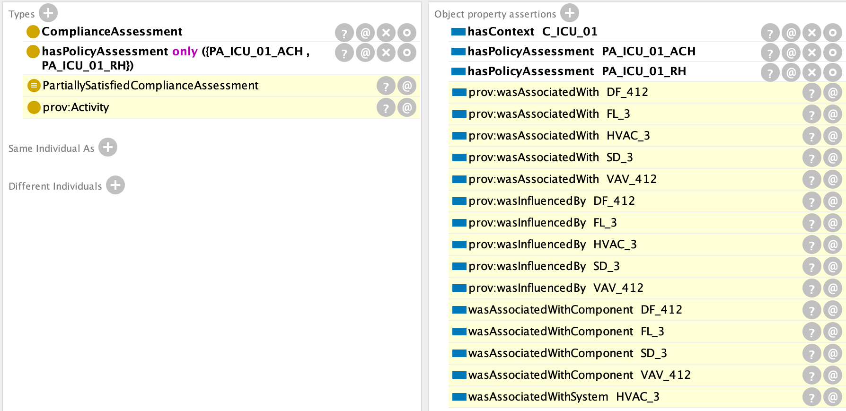
CQ 3.2: Which components of which HVAC system may be causing a room to fall short of the minimum outdoor air changes per hour policy?

Slide 17
Competency Question 3.2
Which components of which HVAC system may be causing a room to fall short of the minimum outdoor air changes per hour policy?
SPARQL - Snap SPARQL Query tab, Pellet started
SELECT DISTINCT ?roomName ?policyName ?unitName
?componentName ?systemName
WHERE {
?assessment v:hasContext ?context .
?assessment v:hasPolicyAssessment ?pa .
?context v:forRoom ?room .
?room rdfs:label ?roomName .
?pa rdf:type v:UnsatisfiedPolicyAssessment .
?pa v:evaluatedPolicy ?policy .
?pa v:wasAssociatedWithComponent ?component .
?pa v:wasAssociatedWithSystem ?system .
?policy rdf:type v:MinimumAirChangesOfOutdoorAirPerHour .
?policy qu:hasLowerBound ?lb .
?policy rdfs:label ?policyName .
?lb qu:hasMeasurementUnit ?unit .
?unit rdfs:label ?unitName .
?component rdfs:label ?componentName .
?system rdfs:label ?systemName .
}
ORDER BY ?componentName
Reasoning required - OWL DL with SWRL rules
1. SWRL rule S2 fires
Measured 1.4 ACH is below the 2.0 ACH lower bound. One variable binds both units, so mismatched units cannot compare.
2. Transitive provenance
prov:wasDerivedFrom is a sub-property of v:isTransitivelyDerivedFrom
3. SWRL rule S9 assigns blame
Every component acting on any measurement in that chain becomes v:wasAssociatedWithComponent.
4. Transitive part-of
col:hasPart is transitive, so FL-3 is part of HVAC-3 though it is only ever asserted part of AHU-3.
5. SWRL rule S10 lifts to system
Blame moves from component up to the containing system, so the query hard-codes no reference to HVAC-3.
Answer - 4 rows: ICU-01 (room 4E-12) | min outdoor air changes per hour | air changes per hour | HVAC-3
Component column, one per row: DF-412, FL-3, SD-3, VAV-412. AHU-3 is correctly absent - it is part of HVAC-3 but acts on no measurement in the failing chain. These are candidates linked to the failing evidence, not a confirmed cause: per requirement R7 the system narrows the search for a facilities engineer, it does not diagnose.

Slide 18
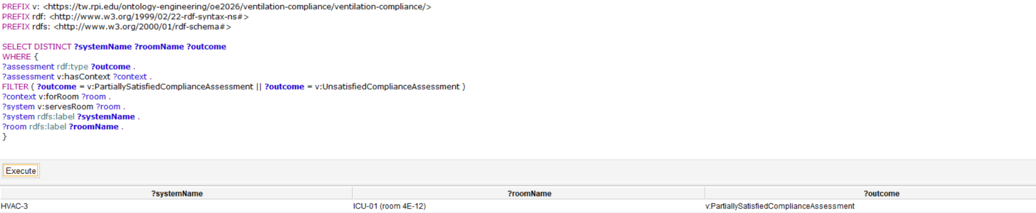
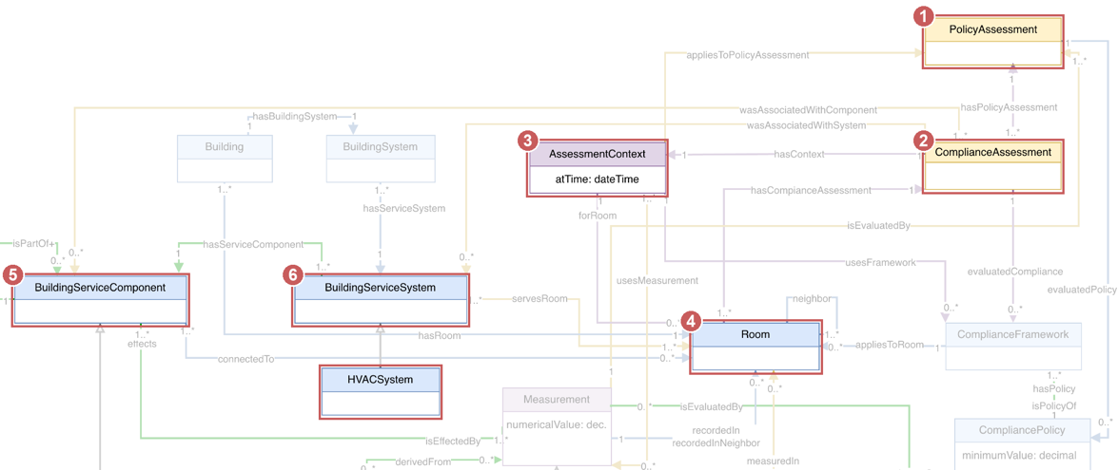
CQ 3.1: Which HVAC system served the rooms that did not meet the standard in the ventilation test on 9 October 2026?
Every column in the answer is inferred. Nothing here is asserted in the individuals file.

Slide 19
Competency Question 3.1
Which HVAC system served the rooms that did not meet the standard in the ventilation test on 9 October 2026?
SPARQL - Snap SPARQL Query tab, Pellet started
SELECT DISTINCT ?systemName ?roomName ?outcome
WHERE {
?assessment rdf:type ?outcome .
?assessment v:hasContext ?context .
FILTER ( ?outcome = v:PartiallySatisfiedComplianceAssessment
|| ?outcome = v:UnsatisfiedComplianceAssessment )
?context v:forRoom ?room .
?system v:servesRoom ?room .
?system rdfs:label ?systemName .
?room rdfs:label ?roomName .
}
Snap SPARQL result
systemName roomName outcome
HVAC-3 ICU-01 (room 4E-12) PartiallySatisfiedComplianceAssessment
Reasoning required - OWL DL with SWRL rules
1. SWRL rules S1-S7
Each measurement is compared against the bound of the policy it is evaluated against, classifying every PolicyAssessment as Satisfied or Unsatisfied.
2. OWL DL class definition
PartiallySatisfiedComplianceAssessment is defined as having some Satisfied and some Unsatisfied policy assessment. A closure axiom on hasPolicyAssessment makes the "only" half usable.
3. Property chain
hasServiceComponent connectsTo -> servesRoom derives which system serves which room. v:servesRoom is asserted zero times in the individuals file.
Answer - 1 row: HVAC-3 | ICU-01 (room 4E-12) | PartiallySatisfiedComplianceAssessment
HVAC-4 is correctly absent: it serves ICU-02 and ICU-03, and both of those classify as SatisfiedComplianceAssessment. In the built-in SPARQL Query tab this returns 0 rows, which is the intended demonstration rather than a fault.

Slide 20
Which HVAC system served the rooms that did not meet the standard in the ventilation test on 9 October 2026?

Slide 21
AI USE
We used AI only to help write the SPARQL queries. We did not use it to revise the ontology or the test individuals.The generated queries gave us a useful starting structure, but none of them ran as written.
Expected answer was checked against the ontology by hand before we accepted it.

